Slide 1
Scaling - II
Blockchains & Cryptocurrencies
Instructors: Matthew Green & Abhishek Jain

Slide 2
Today’s Agenda
Scaling via “off-chain” mechanism: Lightning Network
Fast Consensus Algorithm: Thunderella

Slide 3
A warmup before Lighting Network
(or, simple applications of Bitcoin Script)

Slide 4
“Fair” transactions
Problem: Alice wants to buy a product from an online vendor Bob
Alice doesn’t want to pay until after Bob ships
Bob doesn’t want to ship until after Alice pays
Notes:
Gavel from OpenClipArt.com

Slide 5

Example 1: Fair transactions via Escrow
(disputed case)
(normal case)
Pay x to Bob
SIGNED(ALICE, BOB)
Pay x to Alice
SIGNED(ALICE, JUDY)
Judy
To: Alice
From: Bob
Alice
Pay x to 2-of-3 of Alice, Bob, Judy (MULTISIG)
SIGNED(ALICE)
Bob
Notes:
Gavel from OpenClipArt.com

Slide 6
Micro-payments
Pay-as-you-go WIFI: Alice wants to pay WIFI provider (Bob) for each minute of WIFI service. But she doesn’t want to incur a transaction fee for every minute
Similarly, pay-as-you-go online subscriptions
Ad-free websites
Notes:
What if Bob never paid?

Slide 7
Micro-payments with Bitcoin
Main Idea: Instead of doing several transactions, do a single transaction for total payment (and thus incur only a single transaction fee)
How to implement it?
Notes:
What if Bob never paid?

Slide 8
Micro-payments with Bitcoin
What if Bob never signs??
Input: x; Pay 42 to Bob, 58 to Alice
SIGNED(ALICE) SIGNED(BOB)
all of these could be double-spends!
Input: x; Pay 42 to Bob, 58 to Alice
SIGNED(ALICE)___________
...
Alice demands a timed refund transaction before starting
Input: x; Pay 04 to Bob, 96 to Alice
SIGNED(ALICE)___________
Input: x; Pay 100 to Alice, LOCK until time t
SIGNED(ALICE) SIGNED(BOB)
I’m done!
I’ll publish!
Input: x; Pay 03 to Bob, 97 to Alice
SIGNED(ALICE)___________
Input: x; Pay 02 to Bob, 98 to Alice
SIGNED(ALICE)___________
Input: x; Pay 01 to Bob, 99 to Alice
SIGNED(ALICE)___________
Bob
Alice
Input: y; Pay 100 to Bob/Alice (MULTISIG)
SIGNED(ALICE)
Notes:
What if Bob never paid?

Slide 9
lock_time
{ "hash":"5a42590...b8b6b", "ver":1, "vin_sz":2, "vout_sz":1, "lock_time":315415, "size":404,
...
}
Block index or real-world timestamp before which this transaction can’t be published

Slide 10
Lightning Network
Joseph Poon Thaddeus Dryja
Slides credit: Lightning Network

Slide 11


Unidirectional Channel
Alice and Bob Multisig Channel
1 BTC
Alice
1 BTC
Alice Refund Address
Signed by Bob
30-day nLockTime
1 BTC

Slide 12



Unidirectional Channel
Alice
0.9 BTC
Alice and Bob Multisig Channel
1 BTC
Alice
1 BTC
No nLockTime
Signed by Alice
Bob
0.1 BTC
Alice Refund Address
Signed by Bob
30-day nLockTime
1 BTC

Slide 13

Unidirectional Channel
Alice
0.8 BTC
Alice and Bob Multisig Channel
1 BTC
Alice
1 BTC
No nLockTime
Signed by Alice
Bob
0.2 BTC
Alice
0.9 BTC
Alice Refund Address
1 BTC
Signed by Bob
No nLockTime
Signed by Alice
30-day nLockTime
Bob
0.1 BTC

Slide 14


Unidirectional Channel
Alice
0.8 BTC
Alice and Bob Multisig Channel
1 BTC
Alice
1 BTC
No nLockTime
Bob
0.2 BTC
Alice
0.9 BTC
Alice Refund Address
1 BTC
Signed by Bob
No nLockTime
Signed by Alice
30-day nLockTime
Bob
0.1 BTC

Slide 15
Bidirectional Channel
Alice and Bob Multisig Channel
1 BTC
Alice
1 BTC
Alice Refund Address
Signed by Bob
30-day nLockTime
1 BTC

Slide 16
Bidirectional Channel - Payment
Alice
0.9 BTC
Alice and Bob Multisig Channel
1 BTC
29-day nLockTime
Signed by Alice
Alice
1 BTC
Bob
0.1 BTC
Alice Refund Address
Signed by Bob
30-day nLockTime
1 BTC

Slide 17
Bidirectional Channel - Payment
Alice
0.8 BTC
Alice and Bob Multisig Channel
1 BTC
29-day nLockTime
Signed by Alice
Alice
1 BTC
Bob
0.2 BTC
Alice
0.9 BTC
29-day
Alice Refund Address
1 BTC
Signed by Bob
nLockTime
Signed by Alice
30-day nLockTime
Bob
0.1 BTC

Slide 18
Reversing Direction
Alice
0.9 BTC
Alice and Bob Multisig Channel
1 BTC
28-day nLockTime
Signed by Bob
Alice
1 BTC
Bob
0.1 BTC
Alice
0.8 BTC
29-day
Alice Refund Address
1 BTC
Signed by Bob
nLockTime
Signed by Alice
30-day nLockTime
Bob
0.2 BTC

Slide 19


Closing Bidirectional Channel
Alice
Alice and Bob Multisig Channel
1 BTC
0.9 BTC
Alice
1 BTC
Bob
0.1 BTC
Alice
0.9 BTC
28-day
nLockTime
Signed by Bob
Bob
Alice Refund Address
1 BTC
Signed by Bob
0.1 BTC
29-day nLockTime
Alice
30-day nLockTime
Signed by Alice
0.8 BTC
Bob
0.2 BTC

Slide 20
3 Party Payments
Bob
Existing Channel
Existing Channel
Alice
Carol
Alice wants to pay Carol, they both have a channel open with Bob

Slide 21

3 Party Payments
Bob
0.01 BTC to Bob
Alice
Carol

Slide 22

3 Party Payments
Bob
0.01 BTC to Bob
0.01 BTC to Carol
Alice
Carol

Slide 23
3 Party Payments - Trust Issues
Bob
0.01 BTC to Bob
Alice
Carol

Slide 24

3 Party Payments - Trust Issues
“0.01 BTC to… I
think I’ll keep this.”
Bob
0.01 BTC to Bob
Alice
Carol
Problem: Bob can simply keep the 0.01 BTC Problem: Carol can claim she never got the coins!

Slide 25
Hash-Locked Contracts
Using hash functions, Alice can prove she sent funds to Carol off-chain
Pay to Contract
Knowledge of R hashed into H proves receipt
Receiver signs a contract stating if R is disclosed funds have been received

Slide 26

Hash-Locked Contracts
Bob
Carol samples a random number R and computes H = hash(R)
R
Hash function
Alice
Carol
H

Slide 27

Hash-Locked Contracts
Bob
Carol sends H to Alice (via non-blockchain communication)
Alice
Carol
H
H
R

Slide 28
Hash-Locked Contracts
Alice sends 0.01 BTC to a new output: Bob & H
To spend it, Bob needs to know R
Bob
0.01 BTC to Bob & H
H
Alice
Carol
H
H
R

Slide 29
Hash-Locked Contracts
Bob
0.01 BTC to Bob & H
0.01 BTC to Carol & H
H
Alice
Carol
Bob sends 0.01 BTC to Carol & H
H
H
R

Slide 30

Hash-Locked Contracts
Bob
Carol’s signature and R
0.01 BTC to Bob & H
H R
Alice
Carol
Carol redeems Bob’s transfer, revealing R
H
H
R

Slide 31

Hash-Locked Contracts
Bob
Carol’s signature and R
Bob’s signature and R
H R
Alice
Bob now knows R and can spend Alice’s transfer.
The coins have gone from Alice to Carol via Bob
Carol
H R
H R

Slide 32
Problem
If Carol refuses to disclose R, she will hold up the channel between Alice and Bob

Slide 33


Hashed Time-Lock Contract
HTLC Output
0.01 BTC
0-nLockTime
requires R
3-day nLockTime
Bob (Payment)
Alice (Refund)

Slide 34
Going beyond three parties
Alice wants to send funds to Dave via Bob and Carol
Bob |  | Carol
Alice
Dave

Slide 35
Going beyond three parties
Dave sends Alice hash H produced from random data R
Bob |  | Carol
Alice
Dave
H
H
R

Slide 36

Going beyond three parties
Bob |  | Carol
HTLC 3-day
H
nLockTime
Alice
Alice & Bob create an HTLC output in the payment channel to pay Bob 0.01 BTC, with a 3-day nLockTime refund back to Alice
Dave
H
H
R

Slide 37

Going beyond three parties
HTLC 2-day nLockTime
Bob |  | Carol
HTLC 3-day
H H
Bob & Carol create an HTLC output in the payment channel to pay Carol 0.01 BTC, with a 2-day
nLockTime
Alice
Dave
nLockTime refund back to Bob
H
H
R

Slide 38

Going beyond three parties
HTLC 2-day nLockTime
Bob |  | Carol
HTLC 1-day
HTLC 3-day
nLockTime
H H
Carol & Dave create an HTLC output in the payment channel to pay Dave 0.01 BTC, with a 1-day nLockTime refund back to Carol
nLockTime
Alice
Dave
H
Dave can now get 0.01 BTC if she discloses R to Carol
H R

Slide 39

Going beyond three parties
HTLC 2-day nLockTime
H H R
Dave discloses R to Carol within 1 day. Carol now has enough information to pull funds from Bob.
Bob |  | Carol
HTLC 3-day
0.01 BTC
nLockTime
Alice
Dave
H
H
R

Slide 40

Going beyond three parties
0.01 BTC
Bob |  | Carol
HTLC 3-day
H R H R
Carol discloses R to Bob within 2 days. Bob now has enough information to pull funds from Alice.
0.01 BTC
nLockTime
Alice
Dave
H
H
R

Slide 41

Going beyond three parties
0.01 BTC
Bob |  | Carol
H R H R
Bob discloses R to Alice within 3 days. Alice can prove she sent funds to Dave.
0.01 BTC
0.01 BTC
Alice
Dave
H R
H R

Slide 42

H R
Broken Channel
Blockchain
0.01 BTC
Bob
Carol
HTLC 3-day
H H R
0.01 BTC
nLockTime
Alice
If Bob and Carol don’t cooperate, Carol immediately closes out the channel and broadcasts all pending transactions in the channel onto the blockchain.
Dave
H
Carol redeems the 0.01 by disclosing the HTLC output and R on the Bitcoin blockchain.
H R

Slide 43
H R
Broken Channel
Blockchain
0.01 BTC
Bob
Carol
H R H R
0.01 BTC
0.01 BTC
Alice
Bob observes R from the blockchain and can pull money from Alice off-chain.
Dave
H R
H R

Slide 44
Timeout
HTLC 2-day nLockTime
Bob |  | Carol
HTLC 1-day
HTLC 3-day
nLockTime
H
H
nLockTime
If R never gets disclosed, timeouts occur sequentially from the destination.
Alice
Dave
This decrementing timeout ensures that everyone can receive funds contingent upon it being sent
H
H
R

Slide 45
Timeout
HTLC 2-day nLockTime
Bob |  | Carol
HTLC 3-day
H
H
nLockTime
If R never gets disclosed, timeouts occur sequentially from the destination.
Alice
Dave
This decrementing timeout ensures that everyone can receive funds contingent upon it being sent
H
H
R

Slide 46
Timeout
Bob |  | Carol
HTLC 3-day
H
H
nLockTime
If R never gets disclosed, timeouts occur sequentially from the destination.
Alice
Dave
This decrementing timeout ensures that everyone can receive funds contingent upon it being sent
H
H
R

Slide 47
Timeout
Bob |  | Carol
H H
The HTLC has now timed out for all channels and every party has updated their channel without the HTLC.
Alice
Dave
H
If one party is uncooperative, that channel is broadcast on the blockchain.
H R

Slide 48
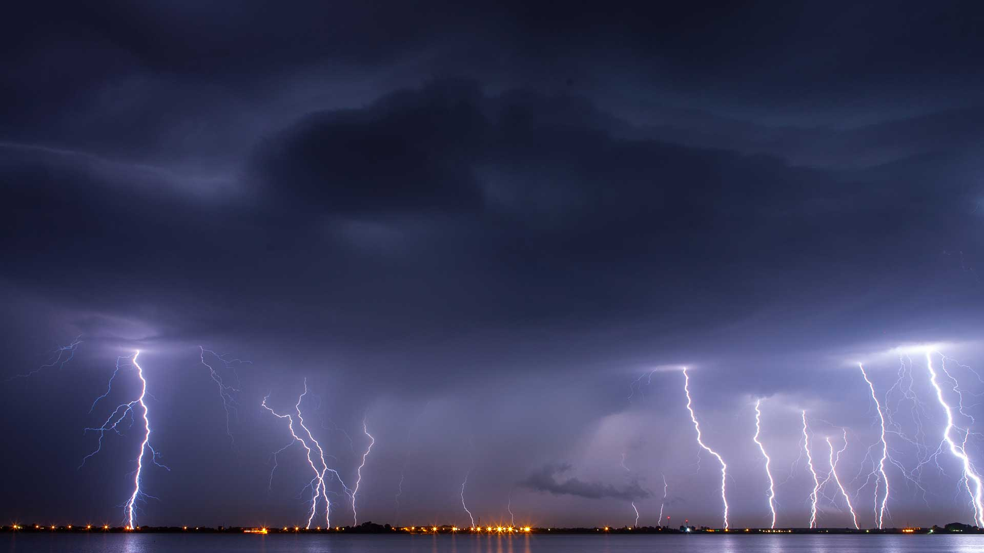
Thunderella
Rafael Pass, Elaine Shi (Thunder Research/Cornell)
Slides credit: Rafael Pass
Notes:
Today i am going to talk about a new consensus protocol that will enable such an extremely fast cryptocurrency

Slide 49



State-machine replication
(a.k.a. linearly ordered log, consensus, blockchain)
Notes:
In distr systems, we care about a very important abstraction called state machine replication

Slide 50
State-machine replication
(a.k.a. linearly ordered log, consensus, blockchain)
Consistency:
honest nodes agree on log
Liveness:
TXs are incorporated soon
Notes:
If you are not familiar with distributed consensus, initially it could be a little deceptive because you might be tempted to think that the problem is easy. And indeed it is very easy if all nodes are honest and correctly following the protocol. However, if some of these nodes maybe compromised for example due to malware, it turns out that achieving consensus is very much non-trivial -- and in this talk we will assume the corrupt or malicious nodes can send arbitrary messages in an attempt to diverge the opinions of honest nodes.

Slide 51

Classical
(e.g. PBFT, Paxos)
Blockchains
Notes:
To answer why there still isn’t a dream solution, we need to take a look at the consensus landscape. There are two broad classes of approaches towards consensus. First, there is classical consensus, when i speak about classical consensus in this talk, i mean state machine rep protocols such as PBFT and Paxos. Of course there have been many works that created optimizations and variants, but fundamentally they are all sort of based on the same framework and paradigm.

Slide 52
Classical
(e.g. PBFT, Paxos)
Fast (most of the time)
Complex
Blockchains

Slide 53
Classical
(e.g. PBFT, Paxos)
Fast (most of the time)
Complex
Simple
Slow
Blockchains
Notes:
Robustness and scalability has been empirically proven. I will also mention a bit more about exactly what notion of robustness blockchains achieve later in the talk, but this could actually be the topic of a future talk

Slide 54
Thunderella [PS’18]
As simple as blockchains
“Optimistic case”: Very fast!
If things “go bad”, fall back to slow blockchain

Slide 55

Classical
(e.g. PBFT, Paxos)
Let’s start with this
Roadmap
Blockchains
Notes:
Before i do that, here’s the plan that i am going to follow. First things first i am going to talk about how classical consensus protocols work. That’s kind of also the chronological order. So i am just going to talk about this until we get stuck

Slide 56
Classical
(e.g. PBFT, Paxos)
Then try both (sort of)
Roadmap
Blockchains
Notes:
And when we do get stuck, we’ll switch gears and try combining ideas from both classical and blockchains.
And i promise that after all of this thought process, towards the end, i will give a 2-sentence explanation of thunderella

Slide 57


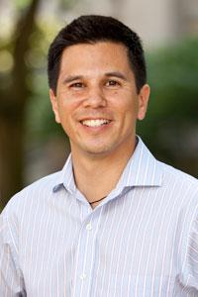



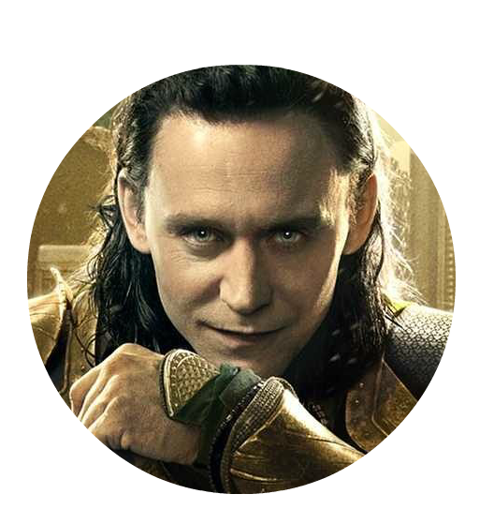

Notes:
Let’s waste no time and look at how classical consensus works

Slide 58


Leader proposes transaction
(Seq, )

Slide 59




Everyone “ack’s”

Slide 60
Everyone “ack’s”
every seq# once!

Slide 61

Confirm on upon “enough” acks

Slide 62
E.g.: Assume ⅔n+1 honest; wait for ⅔n+1 acks

Slide 63


Must intersect at an honest node
⅔n+1
⅔n+1 “Y”
Assume ⅔n+1 honest
Notes:
This argument holds regardless of whether the leader is honest or corrupt. It only depends on people voting honestly

Slide 64
Must intersect at an honest node
⅔n+1
⅔n+1 “Y”
Assume 1/3n malicious
Notes:
This argument holds regardless of whether the leader is honest or corrupt. It only depends on people voting honestly

Slide 65
Must intersect at an honest node
⅔n+1
⅔n+1 “Y”
Thus X = Y
Notes:
This argument holds regardless of whether the leader is honest or corrupt. It only depends on people voting honestly

Slide 66

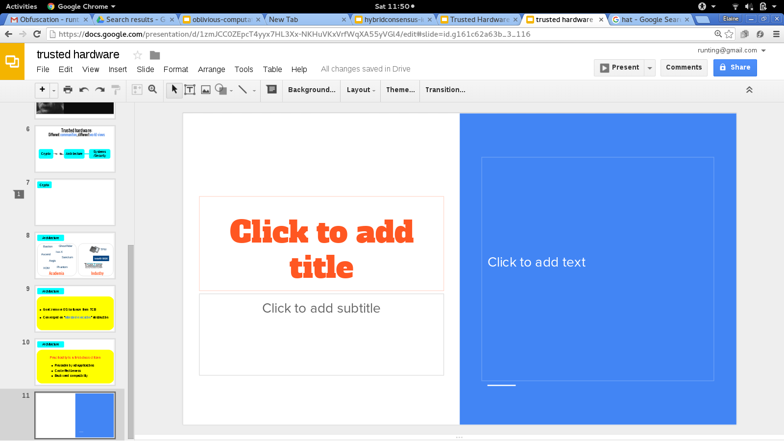
Assume ⅔ honest and online

Slide 67

Assume ⅔ honest and online
Consistency
Liveness

Slide 68


Assume ⅔ honest and online
Consistency
Consistency
Liveness
No liveness

Slide 69
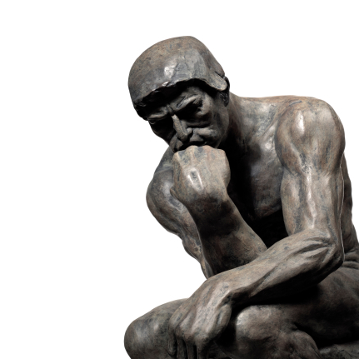
How do we achieve liveness?

Slide 70

How do we achieve liveness?
You don’t want to know …
[PBFT, Paxos...]
Notes:
It’s kind of hazardous to your well-being. you don’t want to know

Slide 71

Anatomy of classical consensus
Simple normal path
Complicated recovery path

Slide 72
Classical
(e.g. PBFT, Paxos)
Roadmap
Then try both (sort of)
Blockchains

Slide 73


Thunderella
blockchain

Slide 74


Leader (a.k.a. accelerator)
Committee
(e.g., recent miners or "stakeholders” (LATER in CLASS))
blockchain miners
Notes:
In fact, for concreteness i am going to use ethereum’s favorite scenario as an example

Slide 75
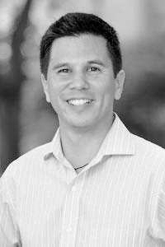
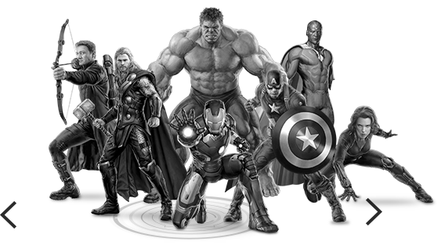

“Optimistic” mode: Instant confirmation
honest and online
3/4 fraction honest and online
majority honest
Notes:
So when do we get instant confirmation? We need that the leader be online and honest, and that ¾ of the committee be online and honest --- because this is the number of votes that we need to vote for for instant confirmation. One important thing to note here is that dan is malicious he cannot break consistency and double-spend his money. The best thing he can do is to degrade performance

Slide 76
But, still SECURE as long as:
Arbitrary deviation!
majority
majority honest (but need not be online)
majority honest
Notes:
Throughout this talk i am always going to assume that the blockchain retains security --- this means that we assume that the blockchain miners are majority honest. If this is a pow blockchain, it means that the majority of the mining power is honest. Additionally, we need that the majority of the committee be honest for consistency and worst-case liveness

Slide 77
Must intersect at an honest node
¾n+1
“X”
¾n+1
“Y”
Assume < ½n malicious
Notes:
Remember, all of this is looking at what happens for a single instance for a single sequence number, but later we will need to consider multiple sequence numbers.

Slide 78
Propose (seq, )
Ack

Slide 79






Propose (seq, )
Ack
¾ acks:
notarized

Slide 80

¾ voted:
notarized
Confirm maximal “lucky” sequence

Slide 81
No liveness when
¾ voted:
notarized
Confirm maximal “lucky” sequence

Slide 82

blockchain collects evidence of

Slide 83

blockchain collects evidence of
Now enter slow mode

Slide 84
What evidence do we collect?
Need: faulty nodes cannot implicate honest leader

Slide 85

Accelerator posts heartbeats to slowchain
Committee only signs if Acc has confirmed all recent transactions
posted to slowchain
Notarized hash of
fast path log

Slide 86
Accelerator posts heartbeats to slowchain

Slide 87

k blocks without a heartbeat
k blocks

Slide 88




blockchain collects evidence of
Now enter slow mode

Slide 89


Need: agree on log before entering slow mode
Now enter slow mode

Slide 90
Need: agree on log before entering slow mode
This is an agreement
problem in itself.
Now enter slow mode

Slide 91


Use the slowchain for “fallback”
Now enter slow mode
Grace period: k blocks

Slide 92





Stop optimistic output
Share knowledge
All knowledge → blockchain
Stop participating in fast path
Tell others what you know
Post notarized but uncheckpointed TXs to slowchain
Grace period: k blocks

Slide 93
Summary
k blocks
Grace period
Slow mode

Slide 94
Open Questions
Incentives for honest behavior?
Miners might have different incentives. E.g., maybe want to go to slow mode

